Slide 1
CaseView System Design
--An auto testing windows software
Wen Zhao
July, 2016

Slide 2
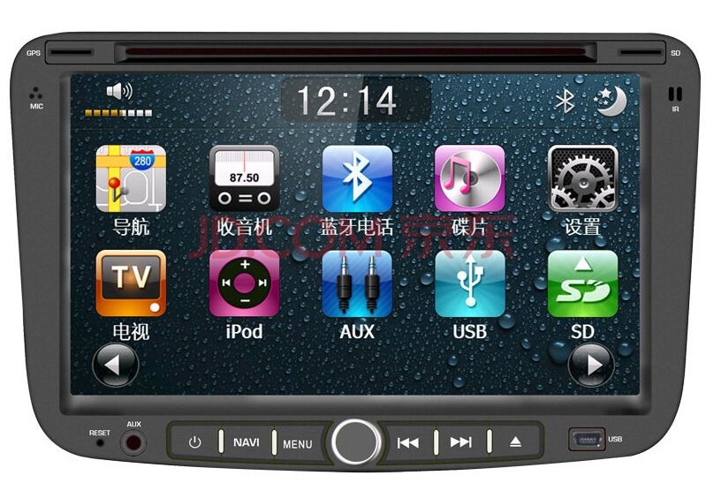
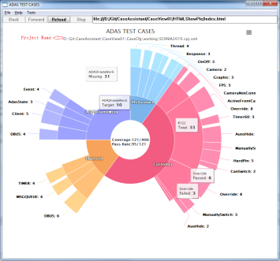
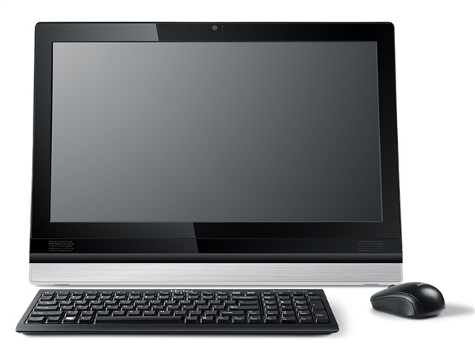
Data flow of the Case Project
Android / QNX /LINUX
ADAS Service
Serial
Command line & Sync
IPC
PPS
DBUS
Tracelib
PC
Socket
Log & Sync
TraceClient
CaseView
Disadvantage:
Target board(QNX): Strong dependences on PPS & DBUS
PC: socket depends on TraceClient
Delay: Serial port introduce long delay
TraceClient: manually operate, auto testing with different config files is not possible
127.0.0.1:4000

Slide 3

Ideal Framework
Advantage:
Target board: no dependence on other processes, feasible for various OS
PC: Easy and Convenient to setup connection, remove dependency on trace client, auto testing is possible
Delay: high speed socket communication
PC
Test Result
CaseView
Database
Socket
cpj.xml
PieChat.xml
Shell script
&&
Sync
Log & Sync
Android / QNX/ LINUX
test result
ADAS
info of CaseListFile
Case view lib(native c++)

Slide 4


Thank You

